Slide 1
BLINKIT DASHBOARD · DATA ANALYSIS
Blinkit Sales and Delivery Performance Analysis
Submitted to: Mr. Shubham Pandey
BLINKIT DASHBOARD · BBA BA 23 · ANANYA CHATURVEDI
Notes:
Good morning. This presentation explains the Blinkit sales and delivery dashboard created in Microsoft Power BI. I will first clarify what the project covers, then show the verified headline measures and the main comparisons in the dashboard. I will also separate what the screenshot confirms from what still needs the source dataset. The main takeaway is a clear, chart-led view of sales, orders, customers, categories, and mapped cities.

Slide 2
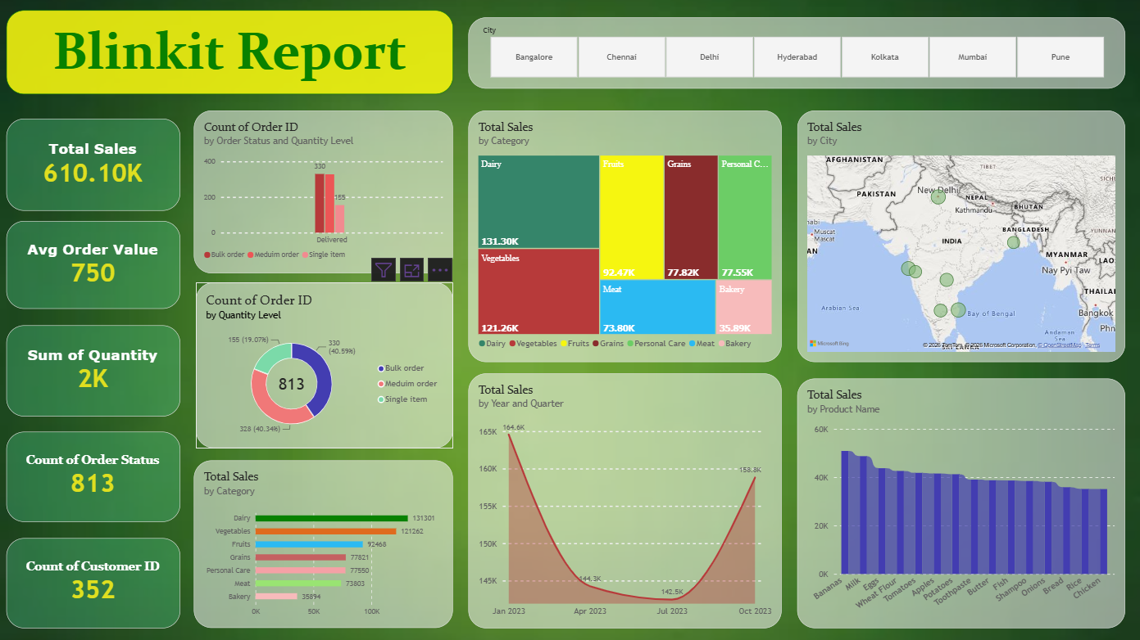

Slide 3
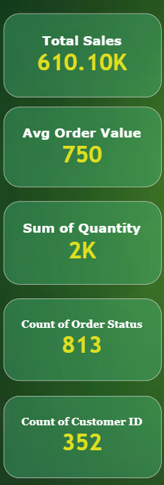



PROJECT SCOPE
KEY FOCUS AREAS
What this project explains
One Power BI dashboard turns Blinkit business data into a view that is easier to compare and discuss.
Sales Analysis of Blinkit Stores across various cities in India.
Revenue Generated in the financial year.
Important areas to improve.
Gross Revenue stands up to 610 k covering many cities like Banglore, Mumbai, Pune, Hyderabad… with around 352 unique customers.
Dashboard Overview
The dashboard provides an overview of Blinkit's sales and order data.
It combines sales performance, product categories, order quantities and other order trends.
It includes geographical analysis using city-level data.
The purpose is to identify patterns and support data-driven business decisions.
It is found that the customers on an avg, order items, costing up to 750 Rs.
So far the store reaches around 813 no of items being successfully delivered to homes.
Notes:
This project has three purposes. First, it brings sales, orders, customers, categories, products, cities, and time periods into one Power BI dashboard. Power BI is Microsoft’s tool for building interactive reports from business data. Second, the charts make comparisons easier than a raw table. Third, the findings can support better inventory and delivery decisions. I will now move from the purpose of the dashboard to the limits of the current source.

Slide 4

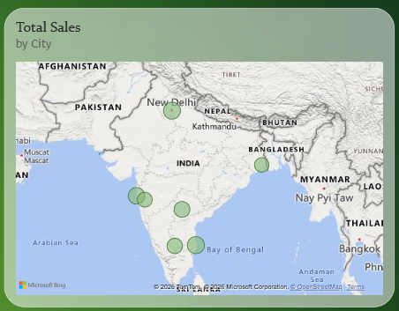
Slicer / Filter
An interactive visual filter that allows users to dynamically filter and explore data on a report page.
USE OF SLICER:
The Map of India
In the dashboard, the slicer shows the cities across which the Blinkit Stores have been reported in the csv file used in power BI.
Using the slicer, we can track in which city the most revenue has been generated.
Here, in this case, Chennai bypasses Delhi, showing around 102 K in Indian Currency.
Thereafter, cities like Mumbai, Hyderabad, Pune rank.
Notes:
This slide is an important data-quality boundary. The screenshot shows dashboard outputs, but it does not show the exact row count, column count, cleaning steps, calculated columns, conditional columns, or DAX definitions. Those fields should be replaced after the uploaded dataset is available. What is verified from the dashboard is 610.10K total sales, 813 orders, and 352 customers. I will use these visible totals in the next slides, while keeping the unknowns clearly marked.

Slide 5
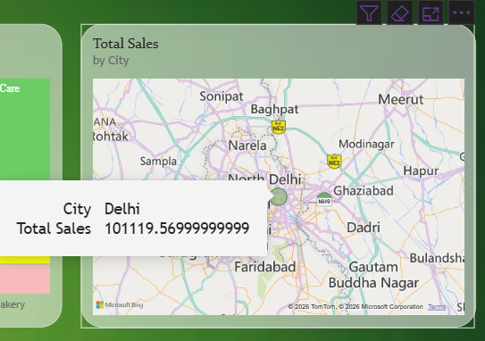
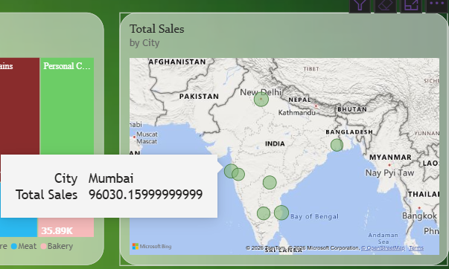
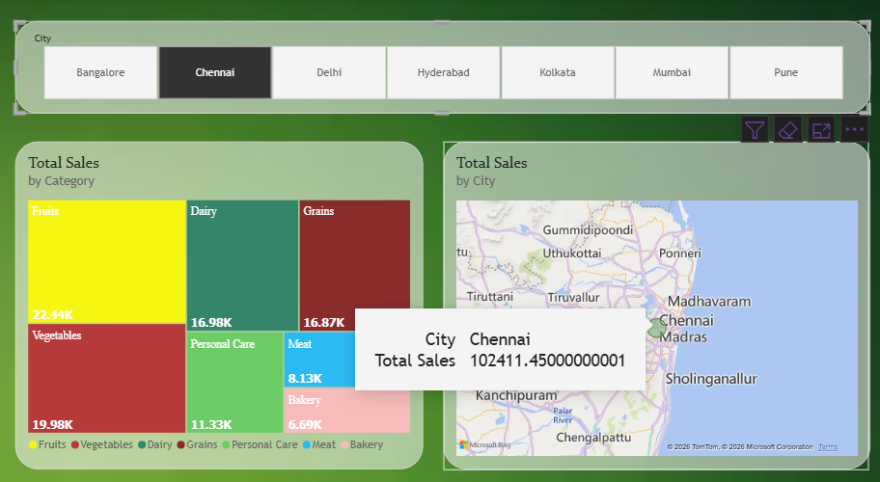
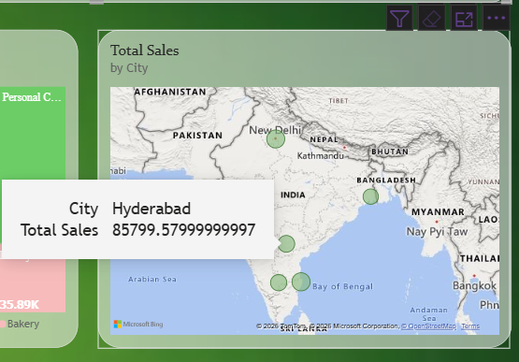
Revenue GenerateD

Slide 6
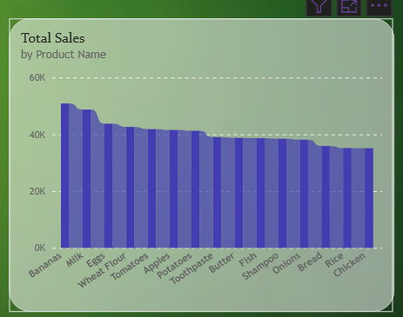
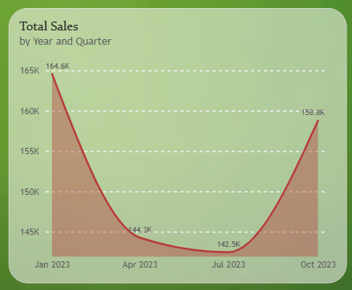
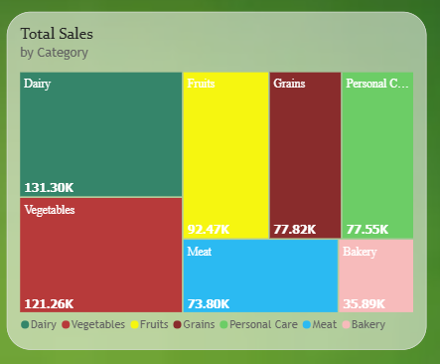



The various charts used
A KPI, or key performance indicator, gives the audience a fast read before the detailed charts.
02 / AVERAGE ORDER VALUE
03 / TOTAL QUANTITY
.
Ribbon Chart
Compare products using their sales values.
It helps explore differences in sales performance between products.
The ranking helps identify products worth investigating further.
Area Chart
Displays how sales change over time.
Peaks indicate periods of higher sales activity.
Starting and ending of the year have more sales than the middle of the year.
Tree Map
The treemap compares sales across product categories.
High demand has been seen in perishable products such as veggies and dairy items.
Notes:
The dashboard opens with three headline measures. Total sales is 610.10K, which is the overall sales value shown in the report. Average order value is 750, the average sales value per order. Total quantity is 2K, the total item quantity shown. These are KPIs because they summarise performance in a small number of figures. They give us the frame for reading the operating scale and order mix that follow.

Slide 7
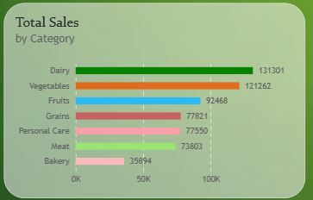
Clustered Bar Chart
Total Sales by Product Category
On an avg, dairy seems to achieve the highest sales rate as a daily commodity.
Chennai tends to have the highest demand for Fruits being near the coat in India.
More people tend to purchase dairy products from Banglore, Kolkata and Mumbai, the fast metropolitian cities.
Key indication:
To ensure availability of dairy stock in blinkit stores through out the cities.
.
Notes:
The operating scale is easiest to understand through two related but different KPIs. The dashboard shows 813 total order records and 352 customer IDs. Orders describe the amount of activity recorded. Customers describe the customer base represented in the dashboard. Reading them together avoids confusing repeated orders with unique customers. This gives the audience a sense of scale before we examine how those orders are divided by quantity level.

Slide 8
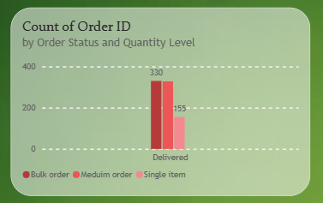
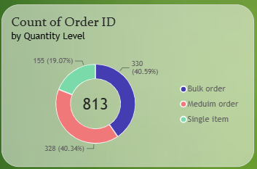
813 ORDERS
Bulk and single-item orders make up almost the entire mix.
Customers purchase items in bulk upto 5-7 goods per order.
The reason: Single orders mostly are charged service fees and
transportation cost.
THE SPLIT
40.59%
Bulk orders · 330
40.34%
Single-item orders · 328
19.07%
Medium orders · 155
Donut Chart
Notes:
The donut chart contains 813 orders in total. Bulk orders are 330, or 40.59 percent. Single-item orders are 328, or 40.34 percent. Medium orders are 155, or 19.07 percent. The important pattern is the balance between bulk and single-item orders. Together they account for almost the full order mix, while medium orders make up the smaller remaining share. The next slide narrows the question to delivered orders by quantity level.

Slide 9
Thankyou

Slide 10
CATEGORY PRIORITIZATION · COMMON SCALE
INSIGHTS
RANKING
Dairy → Vegetables → Fruits → Grains → Personal Care → Meat → Bakery
95,407
Displayed gap between Dairy and Bakery.
Notes:
The horizontal bar chart puts all seven categories on one common scale. The order is Dairy, Vegetables, Fruits, Grains, Personal Care, Meat, and Bakery. The displayed gap between Dairy and Bakery is 95,407. This chart is useful for category prioritization because the ranking is immediately visible. It does not, by itself, explain why the categories differ. To answer that question, we would need the source data and possibly more measures such as time, product, availability, or promotion details.

